Slide 1
CS336 Final Project
Kevin Moran & Kevin Pei

Slide 2
Description
FUBAR is a sports website that can be use to look up basketball and football stats for schools in the Big 10
Includes in depth information about players, the school itself, and the school’s teams
It’s a tool for fans, coaches, and administrators that can be used to explore the factors that contribute to winning teams
It can be used to obtain inside knowledge, found nowhere else, about a particular players criminal history, GPA, injury history, and much more!

Slide 3

Features:
User can:
Create your own data list with parameter fields that you choose
Explore existing queries about BIG10 Basketball and Football Teams
Update the database by inserting new players
Update the database by modifying the information of an existing player (can only do this if you know a players school and secret personal student ID number)
Delete a particular player (maybe they got cut from the team?)

Slide 4
School
Basketball Team
Football Team
Position
Wins
Touchdowns
Plays for
Isa
Tackles
Losses
Passes
Isa
Playing Time
Points Scored
Assists
Team
Rebounds
Status
Coach
Plays for
Player Number
Field Goals
Coach’s Salary
Turnovers
Position
School ID
Funding Spent on Sports
Fouls
Player
Playing Time
Jersey Number
Hometown
Total Budget
Steals
Football Revenue
Blocks
Name
Name
School
Injury Record
School Rank
Average ACT Score
State
GPA
Major
Number of students
Enrollment Rate
Average SAT Score
Weight
Height
Criminal Record
School

Slide 5
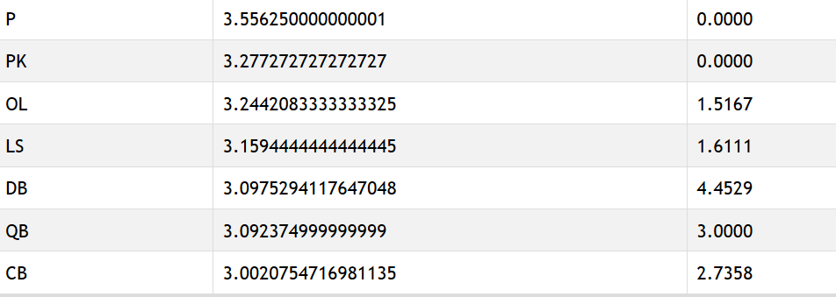
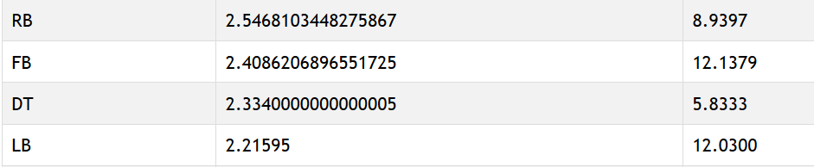
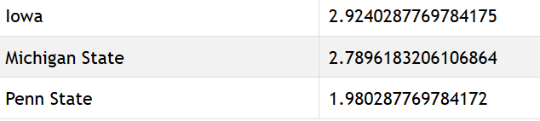
Patterns
GPA is related to injuries (unless you’re Penn State) and injuries are determined by position
Query:
SELECT a.Position, AVG(b.GPA), AVG(b.INJURIES)
FROM PlaysForF a, PlayerData b
WHERE a.IDnum = b.IDnum AND a.School = b.School
GROUP BY a.Position
ORDER BY AVG(b.INJURIES) desc

Slide 6
Patterns
Position determines a football player’s stats
SELECT f.POS, AVG(f.TACKLES), AVG(f.TOUCHDOWNS), AVG(f.FIELD_GOALS)
FROM PlaysForF f
GROUP BY f.POS
ORDER BY f.POS DESC
POS | AVG(f.TACKLES) | AVG(f.TOUCHDOWNS) | AVG(f.FIELD_GOALS)
WR | 0 | 0.8571428571428571 | 0
TE | 13.25 | 0 | 0
S | 36.4 | 0 | 0
RB | 36.16379310344828 | 5.758620689655173 | 0
QB | 10.525 | 1.925 | 0
PK | 0 | 0 | 14.545454545454545
P | 0 | 0 | 0
OT | 88.18181818181819 | 0.45454545454545453 | 0
OL | 53.19166666666667 | 0.44583333333333336 | 0
NT | 51.5 | 0 | 0
LS | 0 | 0 | 0
LB | 54.215 | 0 | 0
G | 72.4 | 0 | 0
FB | 56.827586206896555 | 2.7586206896551726 | 0
DT | 34.3 | 0 | 0
DL | 26.705882352941178 | 0 | 0
DE | 33.440677966101696 | 0 | 0
DB | 49.029411764705884 | 0 | 0
CB | 24.150943396226417 | 0 | 0
C | 253 | 0 | 0

Slide 7
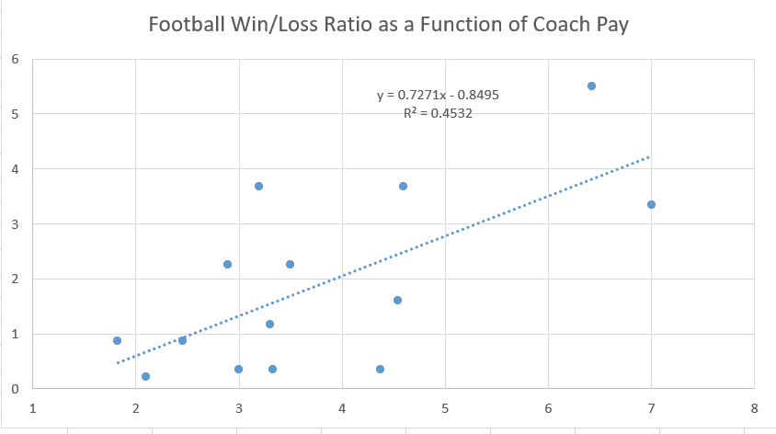
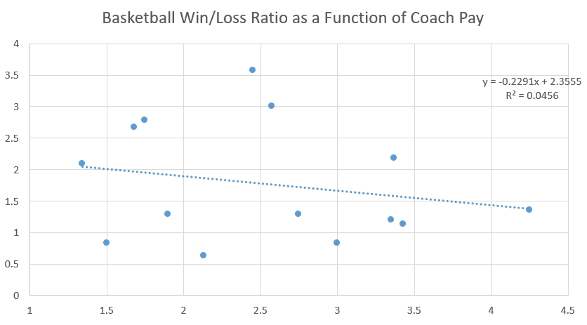
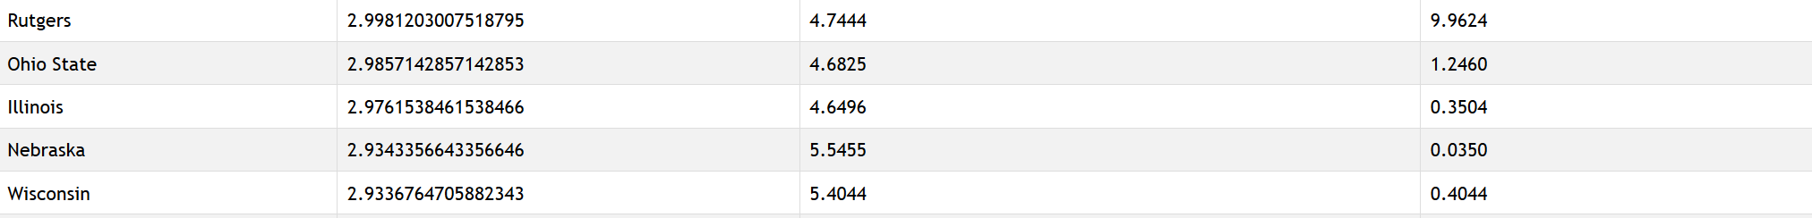
Interesting Finds
Win/Loss Ratio has a positive relation to Coach’s Pay in Football, but not in Basketball
Rutgers players commit a lot of crimes!

Slide 8
Interesting Finds
A school’s endowment affects their crime rate (except for Rutgers)
SELECT s.SCHOOL, s.ENDOWMENT, AVG(p.CRIMES)
FROM SchoolData s, PlayerData p
WHERE s.SCHOOL = p.SCHOOL
GROUP BY s.SCHOOL
ORDER BY s.ENDOWMENT DESC
SCHOOL | ENDOWMENT | AVG(p.CRIMES)
Michigan | 9743000000 | 6.6424
Northwestern | 9648000000 | 7.6429
Penn State | 3602000000 | 1.2609
Ohio State | 3579000000 | 1.2460
Minnesota | 3281000000 | 1.1154
Wisconsin | 2419000000 | 0.4044
Illinois | 2291000000 | 0.3504
Purdue | 2255000000 | 0.3158
Michigan State | 2225000000 | 0.3206
Indiana | 1986000000 | 0.1905
Nebraska | 1475000000 | 0.0350
Iowa | 1259000000 | 0.0000
Rutgers | 1077000000 | 10.0379
Maryland | 280300000 | 0.0000

Slide 9
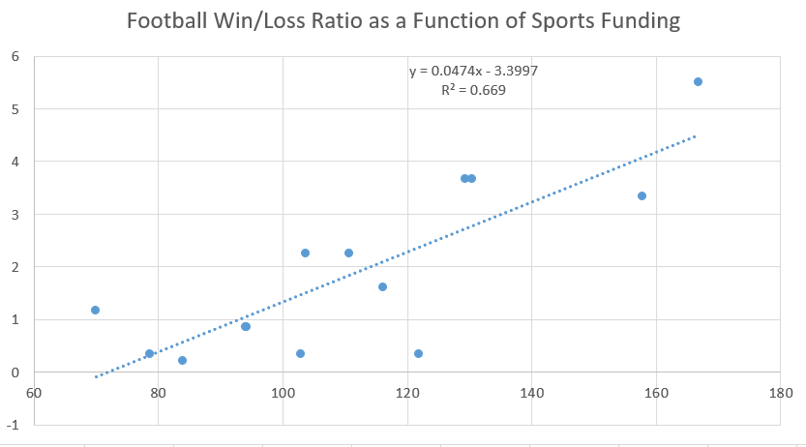
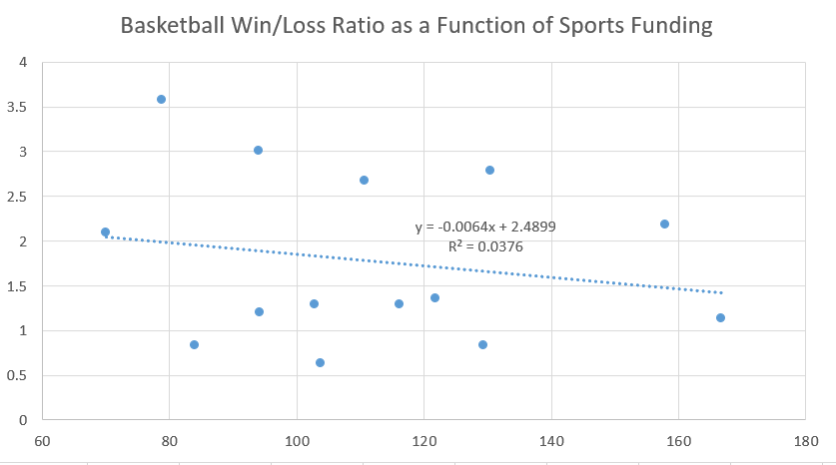
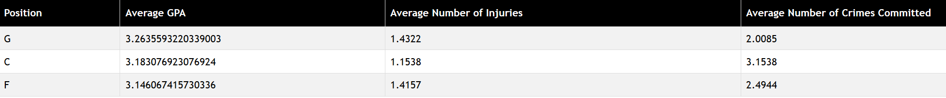
More Discoveries
Win/Loss Ratio has a positive relation to sports expenses in Football, but not in Basketball
A basketball players position does not impact a players GPA or injury record; however, certain positions have longer criminal histories.

Slide 10
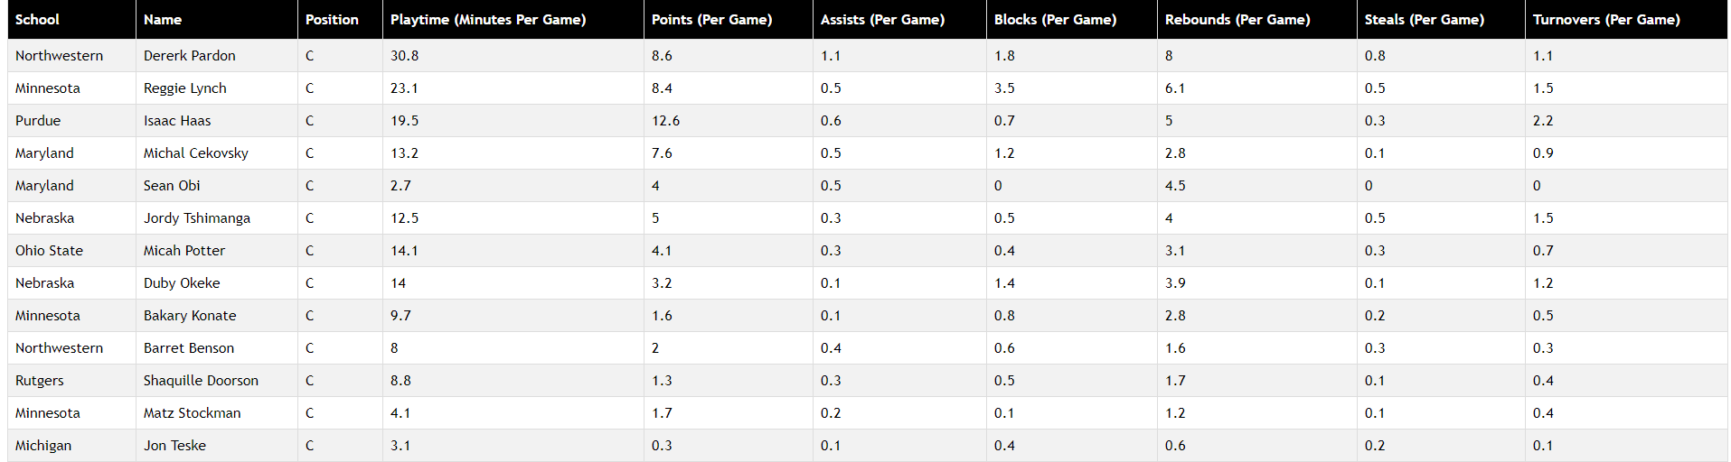
More Discoveries
The higher a player’s play time, the better their stats

Slide 11
More Discoveries
A basketball player’s stats are determined more by weight than by height
But both have only marginal effects at best

Slide 12

Conclusion
FUBAR brings immense power to the hands of its user. Never before has a fan, coach or athletic director been able to look at their opponents in such a thorough and personal way.
FUBAR will help users identify a teams strong points and, at the same time, their weaknesses.
FUBAR will help your team win!

Slide 13
Sources
We collected data from http://www.espn.com/college-football/team/roster/_/id/164 for football players and http://www.espn.com/mens-college-basketball/team/roster/_/id/164 for basketball players
https://www.usnews.com/best-colleges/rankings/national-universities, https://blog.prepscholar.com/big-10-schools, https://thebestschools.org/features/richest-universities-endowments-generosity-research/, and http://msa.maryland.gov/msa/mdmanual/25univ/umcp/html/umcpb.html for school data like ranking, SAT scores, and endowment
http://sports.usatoday.com/ncaa/finances/, http://www.nwherald.com/2016/01/27/what-big-ten-athletic-departments-spentmadepaid-in-2014-15/aohcy86/, and http://www.pennlive.com/pennstatefootball/index.ssf/2017/05/penn_state_football_b1g_revenu.html for school revenue and expenses

